Slide 1
BNSSG Adult Community Services
Healthwatch North Somerset AGM
29th October, 2019

Slide 2

Strength
Trust
Courage
Common Sense

Slide 3
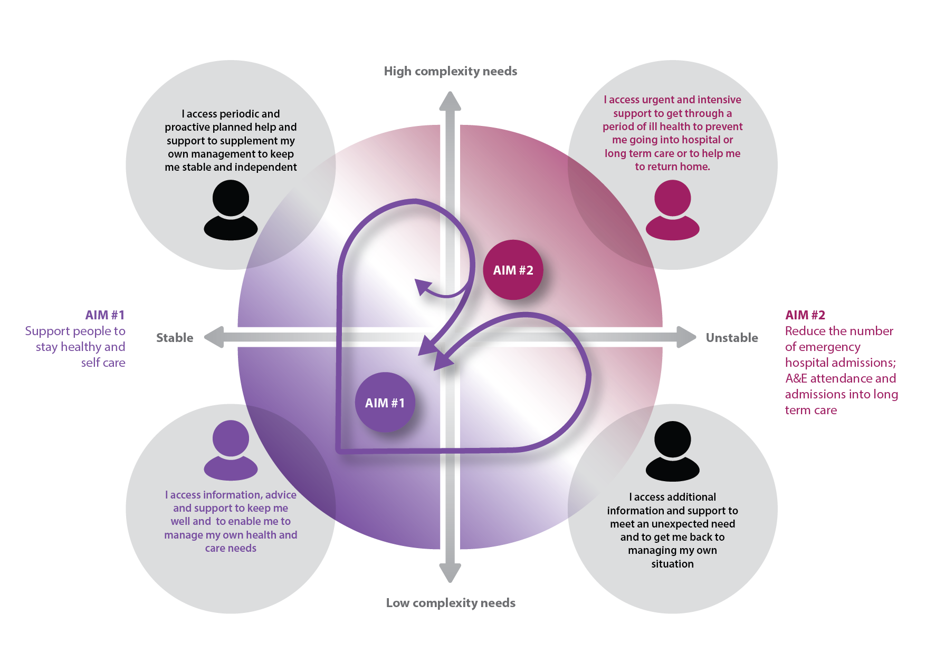
Integrated Care Approach

Slide 4


Community Based Model of Care
PCN
PCN
PCN
Inner City & East Bristol INTs x 3
PCN
Locality
Hub
PCN
PCN
South Bristol
INTs x 3
North & West Bristol INTs x4
PCN
Specialist
Advice &
Support
Specialist
Advice &
Support
Primary Care Networks (PCNs)
Locality Hubs
Integrated Network Teams (INTs)
Acute and Reactive Care
Specialist advice and support
Locality
Hub
Locality
Hub
PCN
PCN
ACUTE & REACTIVE CARE
ACUTE & REACTIVE CARE
PCN
Specialist
Advice &
Support
Specialist
Advice &
Support
Community Based
Model of Care
PCN
Locality
Hub
Locality
Hub
Weston & Worle INTs x 1
Specialist
Advice &
Support
Specialist
Advice &
Support
South Gloucstershire INTs x 5
PCN
Locality
Hub
PCN
PCN
PCN
PCN
Woodspring INTs x 2
PCN
PCN

Slide 5
Integrated Network (Locality) Teams
Built around GP Practices
  Multi-disciplinary
  Aligned Staff
  Strong Presence in practices
  Flexible and integrated working
Organised/Managed at Primary Care Network Level
  18 Integrated Network Teams
  Mobile Working
Membership
  Community Matron
  District & Community Nurses, Therapists plus highly trained support staff
  Pharmacists
  Health Visitors for Older People linked to social prescribers
  Administrative Support
  Partner Agencies – Social Care; Mental Health; Third Sector
Support to Care Homes
Enablers
Closely integrated with Acute & Reactive Services

Slide 6
Locality Hubs
Focus on Health and Wellbeing
  Advice and Signposting
  Links with Third Sector
  Physical and Virtual
  Strong use of Digital Technology
Co-location of Services
  Frailty
  Secondary Care Outpatients
  Specialist Services
Focus for Locality Based Frailty Service
  Frailty Day Assessment Units – “Chairs”

Slide 7
Acute & Reactive
Focus on Urgent Care
  Emergency Care Practitioners
  Advanced Healthcare Practitioner
  Frailty Day Assessment Units – “Chairs”
  Close working with secondary care
Single Point of Access
  Single number and e-mail address
  Standardised Operating Procedures
  Alignment with ICB
Urgent Treatment Centres
Opportunities for joined up Out of Hours Services
Close alignment with INTs
Community Beds
  21 days Length of Stay
  Mixed Provision to include
    Step Up
    Step Down - Rehabilitation
    Safe Haven

Slide 8
Specialist Advice & Support
Highly Trained Specialist Staff across 14 key areas
Advice and Support to all professionals working in locality
  Direct advice
  Education and training
  Joint provision of services
Direct care for very complex conditions
Aligned to INTs/Locality Hubs
  Centrally managed; locally provided
Alignment with secondary care
  Including 24/7 cover
Levelling up to achieve consistency across BNSSG

Slide 9
1. North and West Bristol
2. Inner City East
3. South Bristol
4. Woodspring
5. Weston & Worle
6. South Gloucestershire
Director of Operations
Associate Directors of Locality
Safeguarding Adults Lead
Associate Director
Specialist Services
Key interface with Primary Care and with aligned social care teams/Focus on admission avoidance
Safeguarding Adults Area Lead
Specialist Services Managers
1. Learning Disabilities
2. MSK & Podiatry
3. Specialist Nursing Services – Heart Failure, Diabetes, Continence, Lymphoedema, Dermatology, Tissue Viability Nurse, PD, End of Life
4. Specialist Rehab Services – Falls, Respiratory, Neurology
5. Homelessness, Haven & TB
Integrated Locality Teams (ILTs) Manager
(ILTs x 18 across 6 localities)
Locality Same Day
Emergency Care Manager
LARC inc. Emergency Care Practitioners, Urgent Emergency Care, Minor Injuries Unit,
Walk in Centre, Frailty Day Assessment Unit
Locality Wellbeing Manager
Access & Flow Manager
(ICB/Rehab beds) S. Glos Locality. S. Bristol Locality, Woodspring Locality
Assistant ILT Manager
Key interface with 3rd sector/Vol orgs. Focus on prevention
& self care
Key interface with Secondary Care. Focus on discharge facilitation

Slide 10
Summary
Joining up and building resilience across the system – especially primary and community services
Strengths Based; Focus on Prevention & Early Intervention; Promoting Independence
As much local autonomy as possible within constraints of organisational imperatives; performance measures; best use of resources; safe and effective care
New ways of working
  For Providers and Commissioners
  Primary Care Networks/Integrated Care Partnerships
We don’t have all the answers – need to work together to learn; flex; respond; experiment
Contract doesn’t start until April 2020

